Slide 1
0
Marketing Campaign Insights.
Uncovering Key Insights Using Exploratory Data Analysis.
Adetutu Oduyemi.

Slide 2
Introduction
1
OVERVIEW OF DATASET.
1. Dataset Size: 200,005 entries, 5 columns and 200,006 Rows
2. Unique Target Audiences and Marketing Channels:
5 Target Audiences (Men: 18-24, Men: 25-34, Women: 25-34, Women: 35-44 and All Ages)
6 Marketing Channels (Google Ads, Youtube, Instagram, Website, Facebook and Email)
3. Key Columns: Campaign_ID, Conversion_Rate, ROI, Clicks, Impressions, Acquisition_Cost
4. Data Types: 2 Columns with ‘Floating Point numbers’ (Decimal Numbers), 4 Columns with ‘Integer Numbers’ (Whole numbers) and 9 Columns with ‘Objects’ (string/text data)
ANALYSIS OBJECTIVES
Cleaning the data: fix text columns and convert them to numbers, check for missing values, inconsistencies
Check for outliers and make necessary corrections
Calculate key marketing metrics like CTR and CPC.
Create visualizations to understand campaign performance.
Prepare insights to guide marketing strategies and provide potential areas for further analysis.

Slide 3
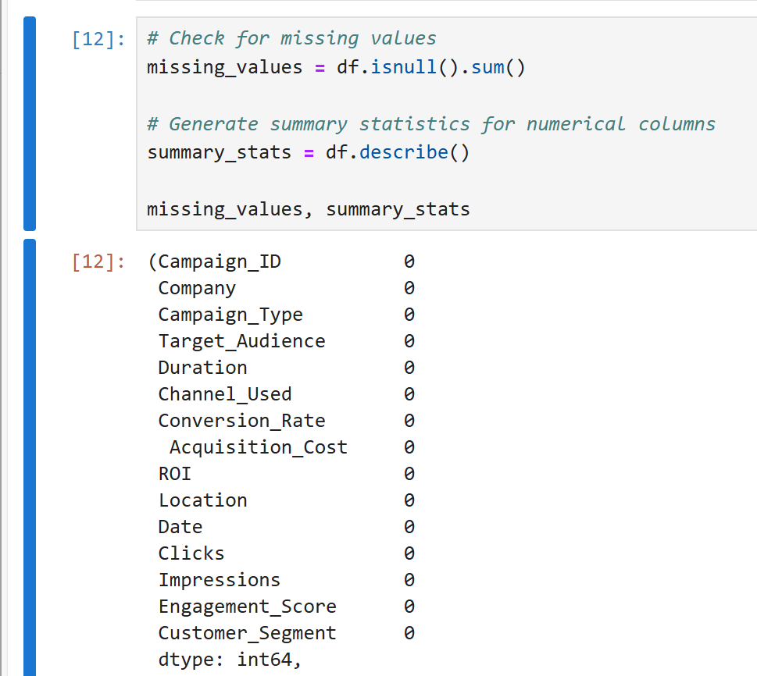
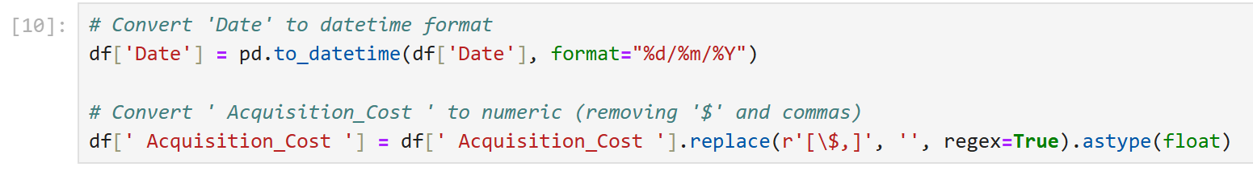
Cleaning the Data.
2
Potential Issues:
The Date needs to be in the Datetime format : This was
corrected first in Excel using “the text to
column” function to have the same
delimiter and have them all in the Date
format.
Acquisition_Cost Column should be in numeric format.
The following codes were used to convert them:
The dataset was checked for missing values and none was gotten.

Slide 4
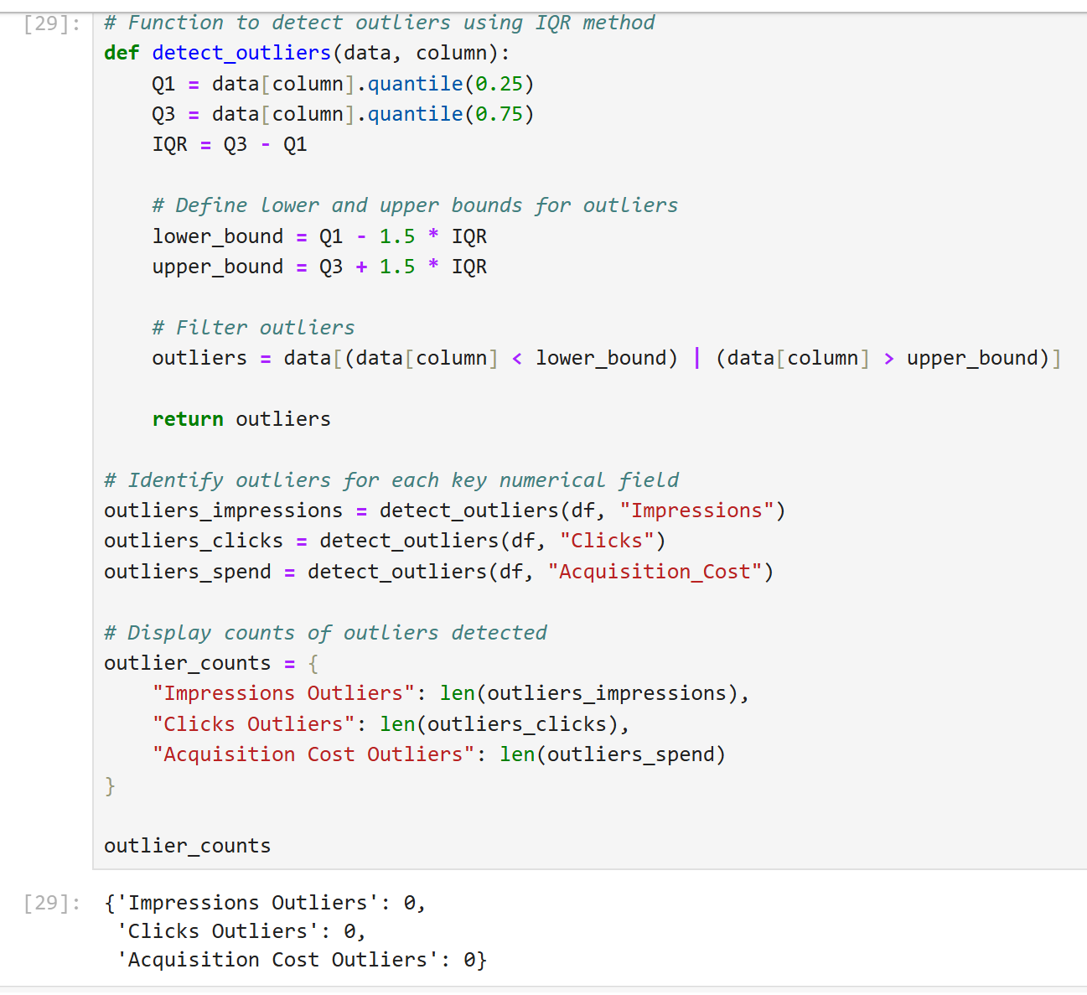
Checking for Outliers.
3
Outliers were checked in Impressions, Clicks and Acquisition Columns using the IQR Method.
Formula for IQR: Q3 (Data [Column] * Quantile [0.25/25%]) - Q1 (Data [Column] * Quantile [0.75/75%]) =IQR
To define outliers:
Lower bound = Q1 - 1.5 * IQR (numbers that fall below the result returns as an outlier)
Upper Bound = Q3 + 1.5 * IQR (numbers that fall above the result returns as outliers)
Result:
No outliers were found.

Slide 5
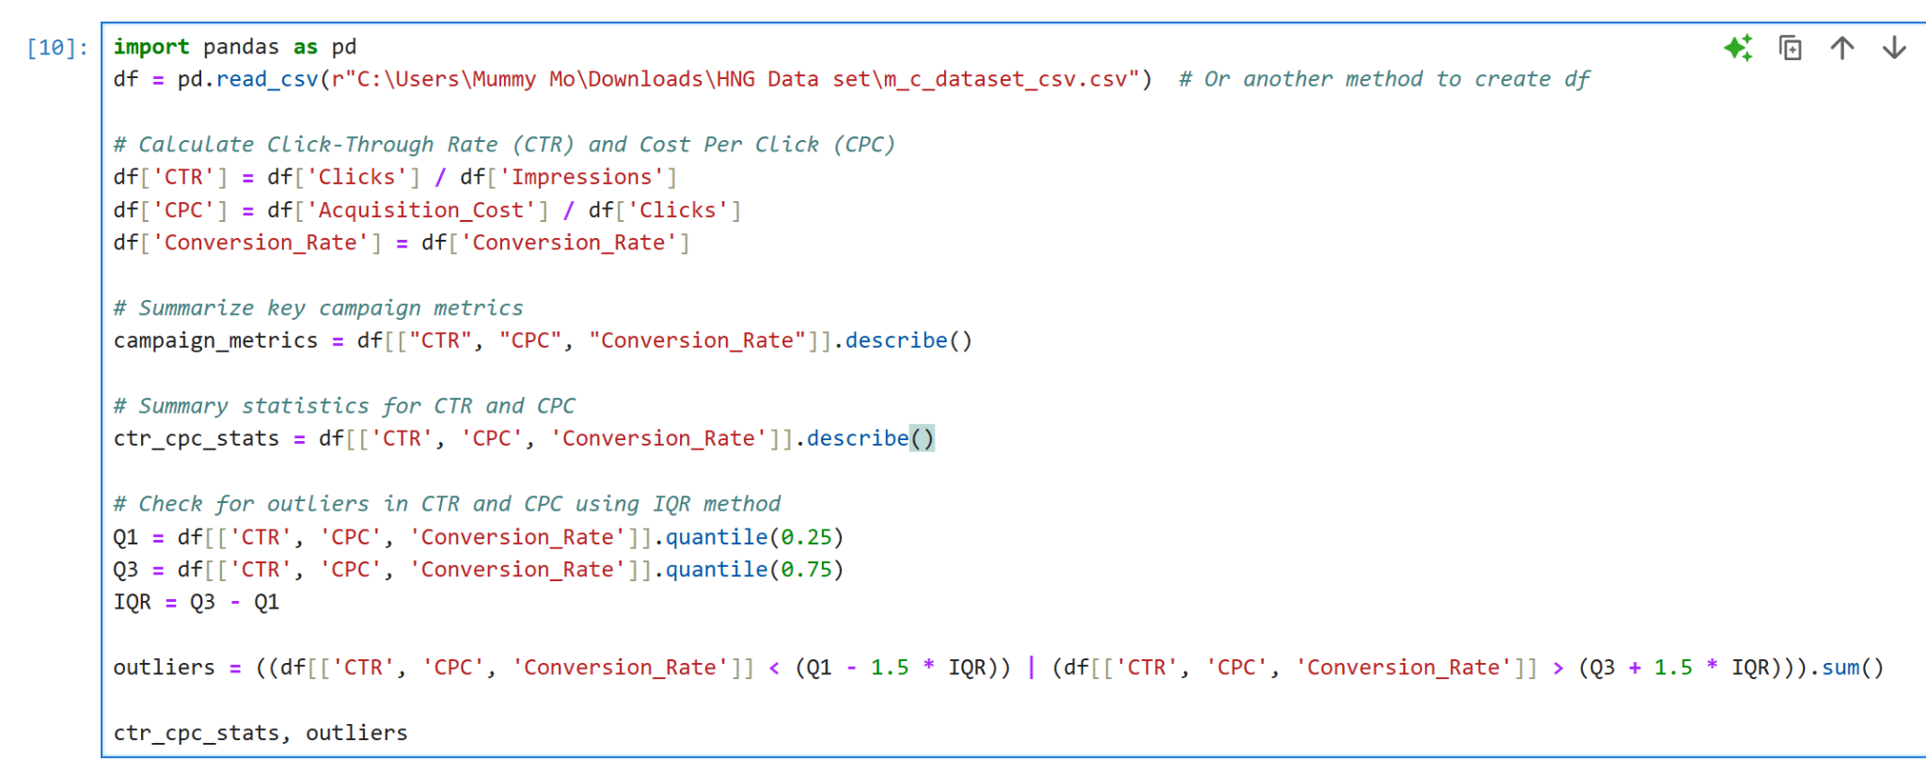
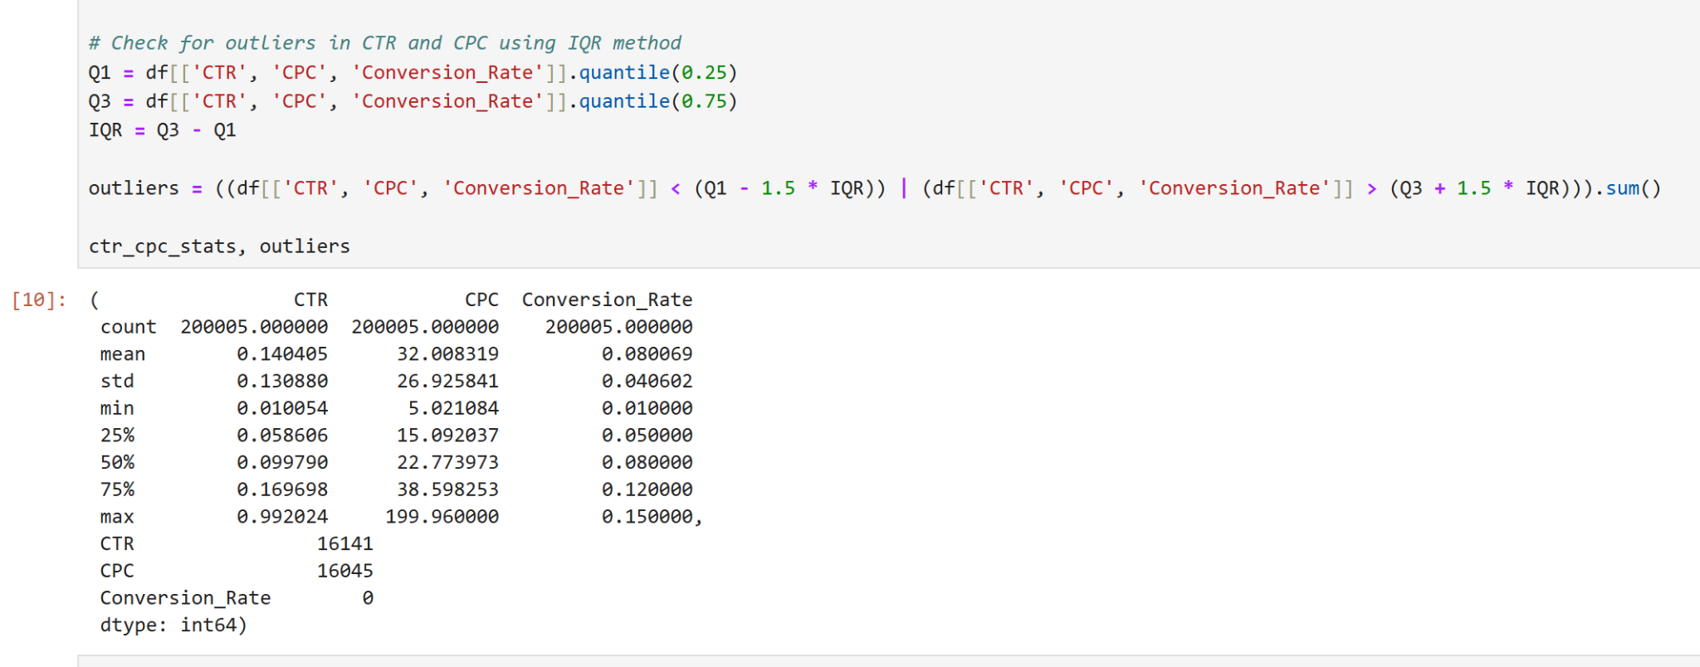
Calculating CTR/CPC and checking for Outliers
4
CTR and CPC were calculated and its statistics too.
Calculating CTR and CPC:
CTR = Clicks / Impressions
CPC = Acquisition_Cost / Clicks
Outliers were checked in CTR, CPC and Conversion_Rate column.
Result:
CTR - 16141
CPC - 16045
Conversion_Rate - 0

Slide 6
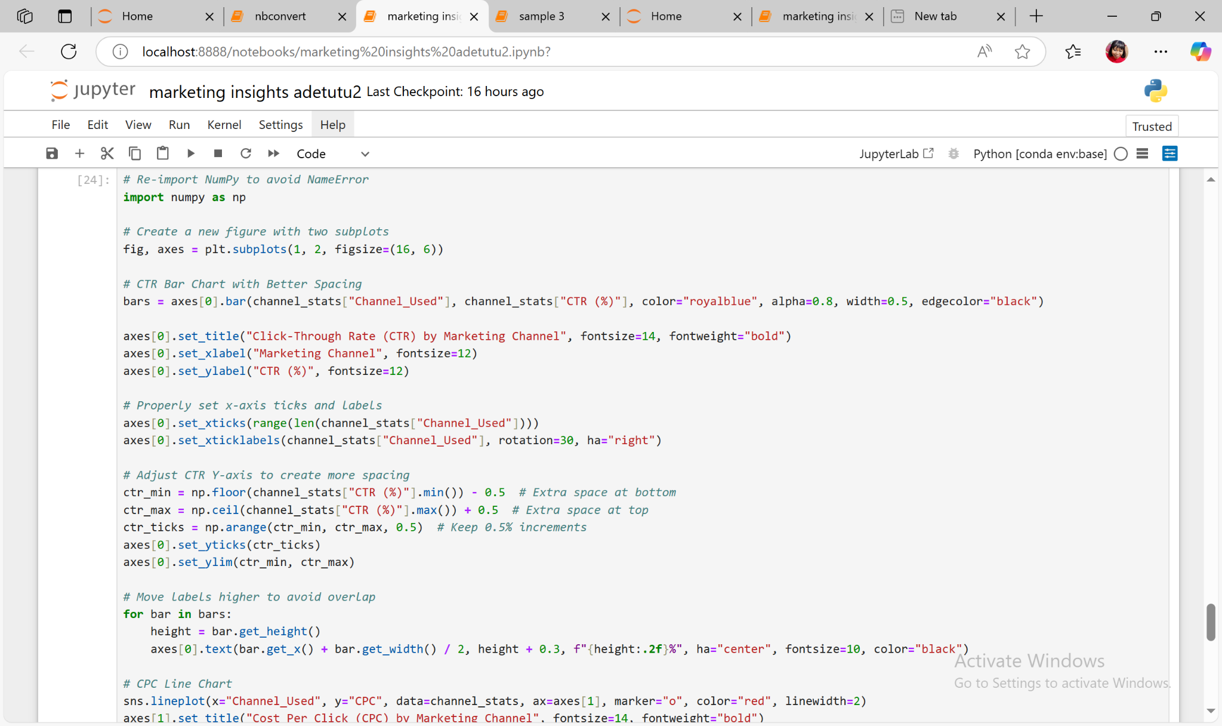
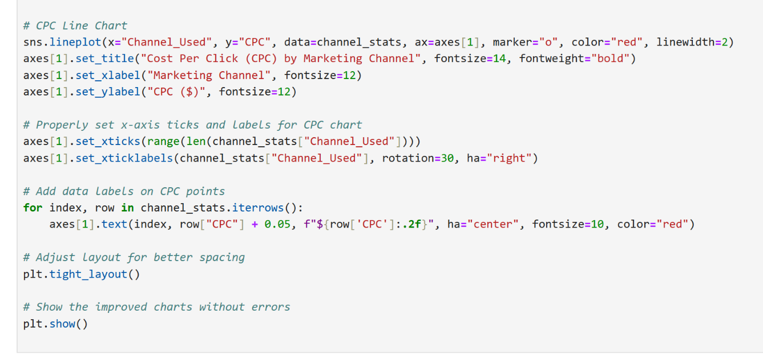
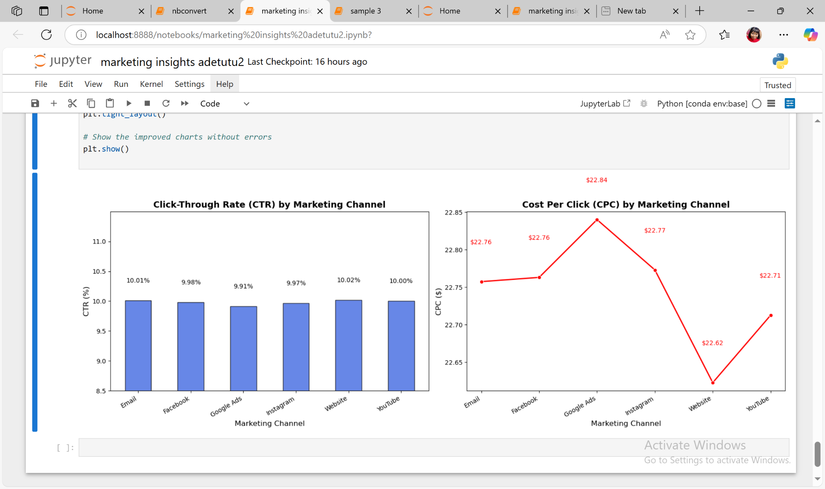
Visualizations to Understand CTR/CPC by Marketing Channels
5

Slide 7
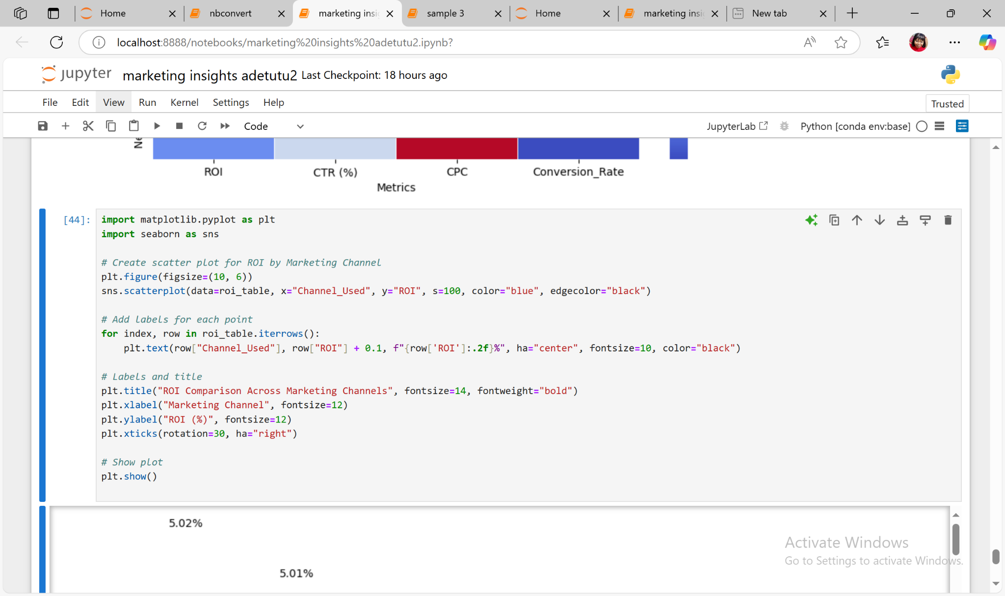
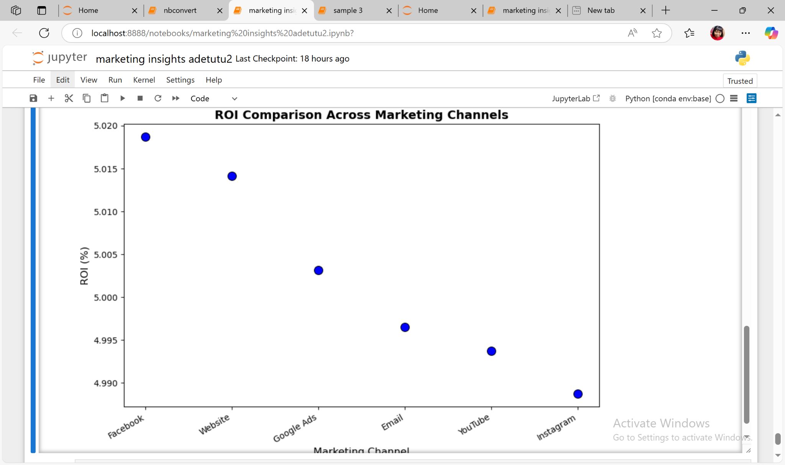
Visualizations to Understand ROI by Marketing Channels
6
INSIGHTS
Facebook has the highest ROI at 5.02%
Instagram has the lowest ROI at 4.99%

Slide 8
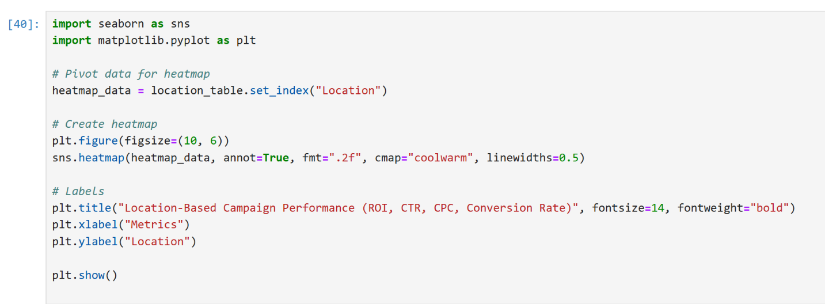
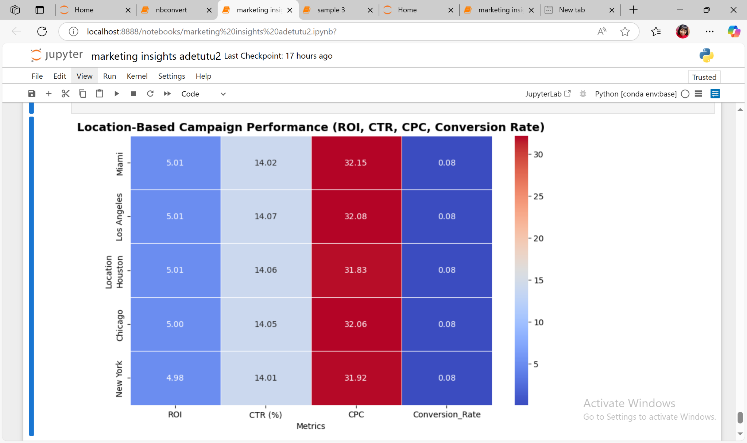
Location-Based Campaign Performance.
7
INSIGHTS
Miami & Los Angeles have the highest ROI (5.01%) → Best-performing locations.
CTR is consistent (~14%) across locations → Indicates similar engagement rates.
New York has the highest conversion rate (8.02%) → Strong audience engagement despite slightly lower ROI.
Miami & Los Angeles have the highest CPC ($32.15 & $32.08) → This could be because these locations has more high income users.

Slide 9
Insights to Guide Marketing Strategies.
8
Marketing Channels Performances
The most cost-effective platforms are Facebook and Website with the highest ROI :
Instagram & YouTube had lower ROI, suggesting less efficient spending.
CTR Trends: Email & Website had the highest CTR, meaning they engaged users the most.
Location-Based Trends
1. Miami & Los Angeles showed higher ROI than other cities. 2. New York had the highest Conversion Rate but slightly lower ROI, meaning users clicked & converted more but at a higher cost. 3. CPC was highest in Miami, meaning ad competition may be stronger in that region.
Cost Per Click (CPC) Insights
Google Ads has high CPC and also high ROI, meaning it could be worth the investment.
Conversion Rate Trends
1. New York had the best conversion rates, meaning campaigns performed well there. 2. Despite high CTR, YouTube & Instagram had lower conversion rates, meaning clicks didn’t always turn into sales. 3. Miami has high ROI despite its low CTR, even with a low engagement it still generated profits.

Slide 10
Marketing Strategies and Areas for Further Analysis
9
Recommendations for Marketing Strategies.
Prioritize Facebook & Website for cost-effective, high-ROI campaigns.
Re-evaluate Instagram & YouTube to see if they need better targeting or ad creative improvements.
Consider region-specific strategies:
Miami & LA have great ROI, so they could be worth more investment.
New York has high conversions but may need budget optimizations.
A/B test Google Ads to see if high CPC is justified by conversions.
Leverage Email & Website for high CTR and engagement-focused campaigns.
Potential Areas for Further Analysis
Are there spikes in engagement during holidays or sales events?
Do specific demographics prefer certain marketing channels?
Do certain ad formats (video, text, display) perform better on different channels?
Why is CPC high in Miami & Google Ads? Is it due to competition, audience targeting, or keyword selection?
Are there opportunities to reduce ad spend while maintaining conversions?
Which marketing channels contribute the most to conversions along the customer journey?

